Slide 1

Bio - Inspired
Modelisation of natural phenomena course
Group Work

Slide 2
History
Notes:
La Carte Auto-Organisatrice (ou Carte Kohonen ou SOM) est un type de réseau de neurones artificiels inspiré des modèles biologiques des systèmes neuronaux des années 1970. Elle adopte une approche d'apprentissage non supervisée et entraîne son réseau à travers un algorithme d'apprentissage compétitif. La SOM est utilisée pour les techniques de clustering et de cartographie (ou réduction de dimensionnalité), permettant de projeter des données multidimensionnelles dans un espace de dimension inférieure, ce qui facilite l'interprétation de problèmes complexes.
La SOM comporte deux couches : une couche d'entrée et une couche de sortie.
L'architecture de la Carte Auto-Organisatrice avec deux clusters et n caractéristiques d'entrée pour un échantillon quelconque est donnée ci-dessous :

Slide 3
Biological Inspiration (youssra)

Slide 4
Principal
Notes:
La Carte Auto-Organisatrice (ou Carte Kohonen ou SOM) est un type de réseau de neurones artificiels inspiré des modèles biologiques des systèmes neuronaux des années 1970. Elle adopte une approche d'apprentissage non supervisée et entraîne son réseau à travers un algorithme d'apprentissage compétitif. La SOM est utilisée pour les techniques de clustering et de cartographie (ou réduction de dimensionnalité), permettant de projeter des données multidimensionnelles dans un espace de dimension inférieure, ce qui facilite l'interprétation de problèmes complexes.
La SOM comporte deux couches : une couche d'entrée et une couche de sortie.
L'architecture de la Carte Auto-Organisatrice avec deux clusters et n caractéristiques d'entrée pour un échantillon quelconque est donnée ci-dessous :

Slide 5
Stockage des infos en ADN (saad)

Slide 6
Principal
ROUGUI Othmane
Notes:
La Carte Auto-Organisatrice (ou Carte Kohonen ou SOM) est un type de réseau de neurones artificiels inspiré des modèles biologiques des systèmes neuronaux des années 1970. Elle adopte une approche d'apprentissage non supervisée et entraîne son réseau à travers un algorithme d'apprentissage compétitif. La SOM est utilisée pour les techniques de clustering et de cartographie (ou réduction de dimensionnalité), permettant de projeter des données multidimensionnelles dans un espace de dimension inférieure, ce qui facilite l'interprétation de problèmes complexes.
La SOM comporte deux couches : une couche d'entrée et une couche de sortie.
L'architecture de la Carte Auto-Organisatrice avec deux clusters et n caractéristiques d'entrée pour un échantillon quelconque est donnée ci-dessous :

Slide 7
Hopfield NN

Slide 8
Principal
ROUGUI Othmane
Notes:
La Carte Auto-Organisatrice (ou Carte Kohonen ou SOM) est un type de réseau de neurones artificiels inspiré des modèles biologiques des systèmes neuronaux des années 1970. Elle adopte une approche d'apprentissage non supervisée et entraîne son réseau à travers un algorithme d'apprentissage compétitif. La SOM est utilisée pour les techniques de clustering et de cartographie (ou réduction de dimensionnalité), permettant de projeter des données multidimensionnelles dans un espace de dimension inférieure, ce qui facilite l'interprétation de problèmes complexes.
La SOM comporte deux couches : une couche d'entrée et une couche de sortie.
L'architecture de la Carte Auto-Organisatrice avec deux clusters et n caractéristiques d'entrée pour un échantillon quelconque est donnée ci-dessous :

Slide 9
Hopfield Nets with Boltzmann Equation (ismail)

Slide 10
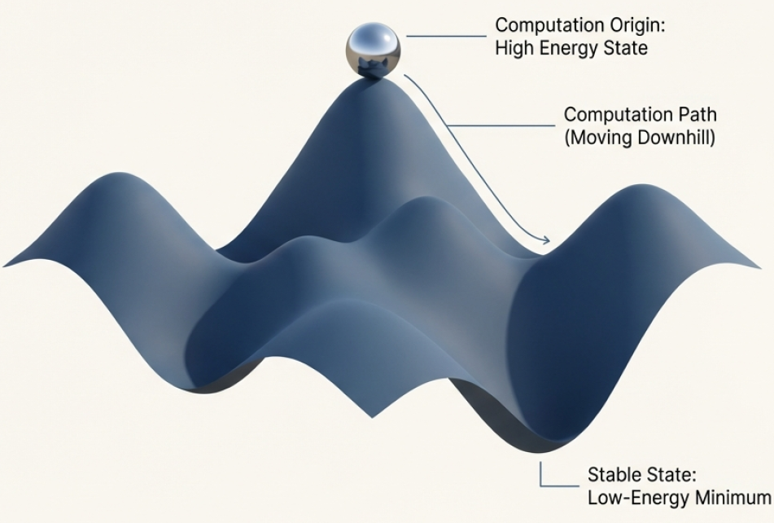
The Core Idea:
Computation as an Energy Landscape
Both Hopfield Networks and Boltzmann Machines operate on a shared principle: a global "energy function." Every possible configuration of the network's units corresponds to a specific energy level, creating a vast, multi-dimensional landscape.
The network's primary goal is to find a low-energy stat a valley in this landscape.
The process of computation is the process of moving ’downhill" on this surface.
As stated by John Hopfield, if the connections between units are symmetric, this global energy function is guaranteed to exist, and the network will always
settle to an energy minimum.

Slide 11
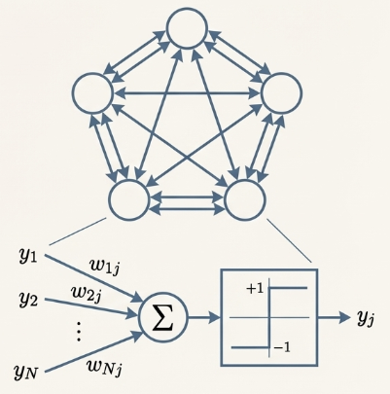
The Hopfield Network
Architecture: A recurrent network of interconnected binary units (+1/-1). Key features are symmetric weights (W_{ij} =W_{ji}) and no self- connections (W_{ii} = 0).
Purpose: To function as a Content-Addressable Memory (CAM). Retrieve a full memory by providing only a partial or corrupted piece of it.
Analogy: “it's like reconstructing a dinosaur from a
few bones.“
Behavior: The network is deterministic. It uses a binary threshold decision rule that always moves the network's state towards a lower energy configuration.

Slide 12
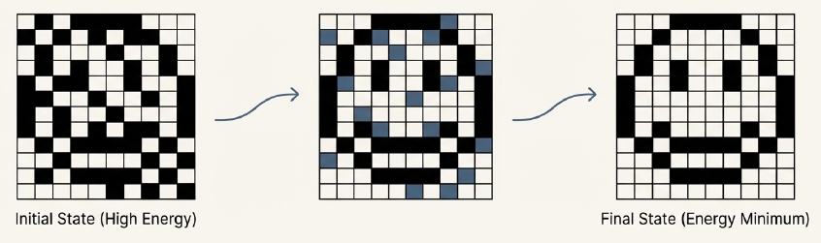
How It Works: Settling into a Stored Memory
The network retrieves a memory through an iterative process:
Initialization: An incomplete or noisy pattern is presented, setting the network's initial, high-energy state.
Asynchronous Updates: Units are updated one at a time. Each unit flips its state only if the flip reduces the global energy of the network.
Convergence: The process stops when no single flip can lower the energy further. The network has reached a stable state—an energy minimum.

Slide 13
The Challenge
While elegant, the Hopfield Network's deterministic nature and simple learning rule (Hebbian learning) lead to significant practical limitations.
These limitations restrict its reliability and efficiency, especially as the number of stored memories increases. The ’perfect’ memory machine begins to show its faults.
Two major problems emerge: the creation of false memories and a severe bottleneck on storage capacity.

Slide 14
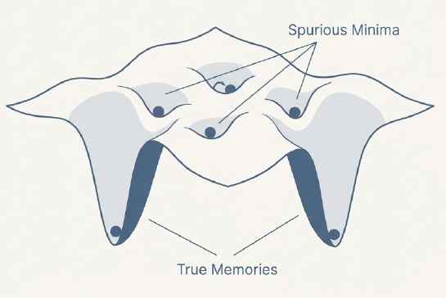
The Problem of Spurious Minima
The process of storing desired patterns (creating deep energy valleys) inadvertently creates other, unintended stable states in the network. These "spurious minima" are false memories. If the network starts from certain initial states, it can get trapped in these valleys, retrieving a pattern that was never explicitly stored.

Slide 15
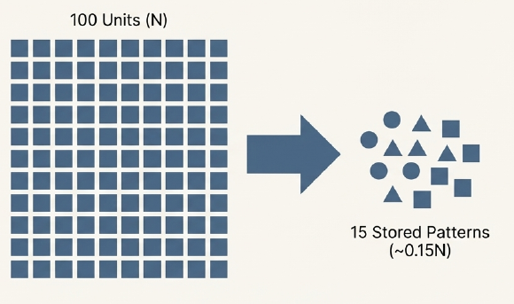
The Problem of Spurious Minima
The Limitation: A fully connected Hopfield Network with N units has a surprisingly low storage capacity. It can only reliably store approximately 0.15N memory patterns.
Implication: To store just 15 patterns, you need a network of 100 units. This scaling is highly inefficient.
The Cost: Storing these memories requires N²/2 weights. The information storage is vastly inefficient compared to the number of parameters used.

Slide 16
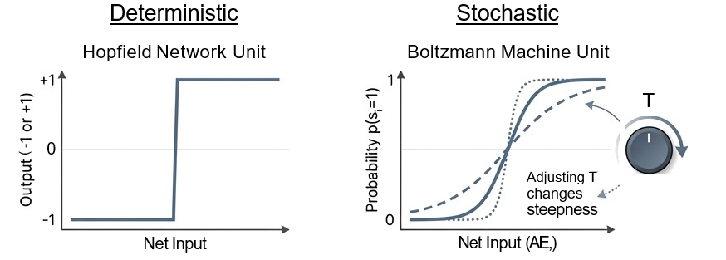
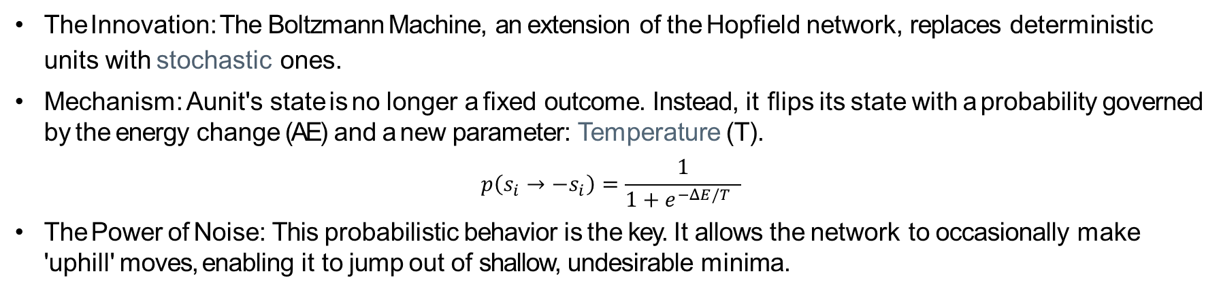
Boltzmann Machine : Introducing Stochasticity
The Innovation: The Boltzmann Machine, an extension of the Hopfield network, replaces deterministic
units with stochastic ones.
Mechanism: A unit's state is no longer a fixed outcome. Instead, it flips its state with a probability governed by the energy change (AE) and a new parameter: Temperature (T).
$$p\left(s_{i}→−s_{i}\right)=\frac{1}{1+e^{−ΔE/T} }$$
The Power of Noise: This probabilistic behavior is the key. It allows the network to occasionally make 'uphill' moves, enabling it to jump out of shallow, undesirable minima.

Slide 17
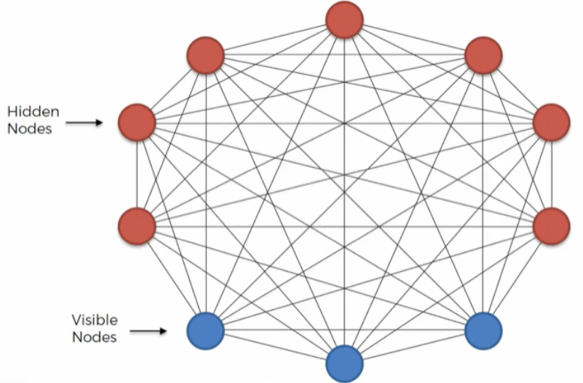
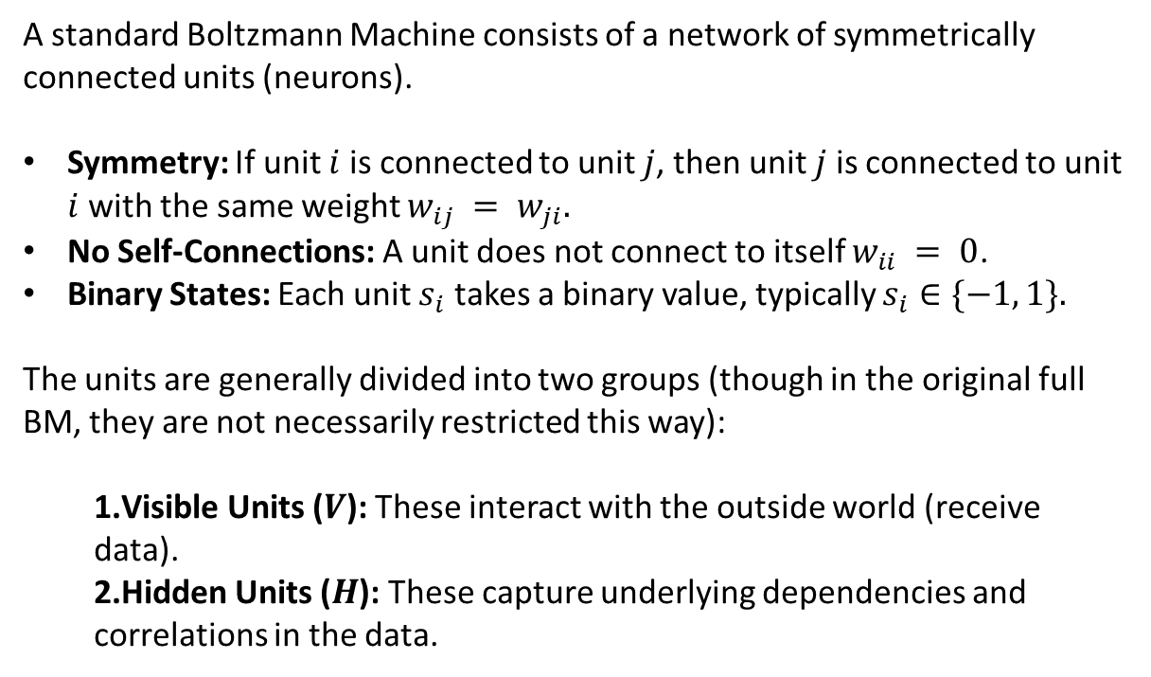
Boltzmann Machine : Architecture
A standard Boltzmann Machine consists of a network of symmetrically connected units (neurons).
Symmetry: If unit $i$ is connected to unit $j$, then unit $j$ is connected to unit $i$ with the same weight $w_{ij} = w_{ji}.$
No Self-Connections: A unit does not connect to itself $w_{ii} = 0$.
Binary States: Each unit $s_{i}$ takes a binary value, typically $s_{i}∈\{−1, 1\}.$
The units are generally divided into two groups (though in the original full BM, they are not necessarily restricted this way):
Visible Units ($V$): These interact with the outside world (receive data).
Hidden Units ($H$): These capture underlying dependencies and correlations in the data.
Notes:
Architectural Shik: Unlike the single-layer Hopfield Network, a Boltzmann machine can have hidden units.
Visible Units: Interface with the external world. Data is clamped onto these units.
Hidden Units: Have no direct connection to the outside. They are free to learn and represent abstract features and correlations within the data.
A New Purpose: With hidden units, the network‘s new role is to construct an internal model or interpretation of the sensory input. The hidden units learn to represent the underlying structure that explains the visible data.

Slide 18
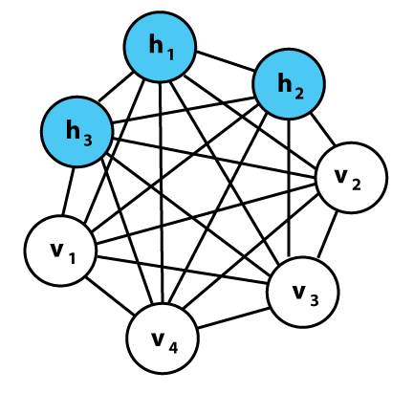
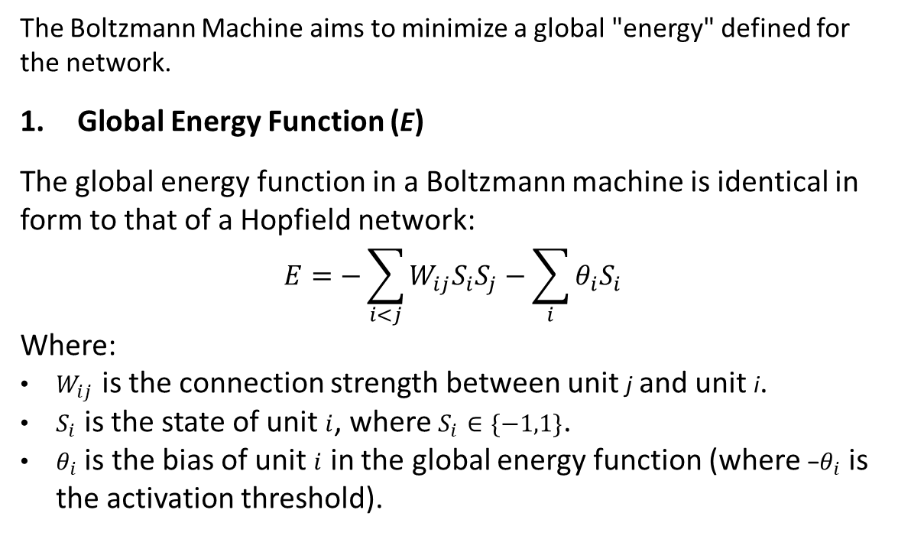
Boltzmann Machine : Mathematical Foundation
The Boltzmann Machine aims to minimize a global "energy" defined for the network.
Global Energy Function (E)
The global energy function in a Boltzmann machine is identical in form to that of a Hopfield network:
$$E=−\sum_{i<j}{W_{ij}S_{i}S_{j}}−\sum_{i}{θ_{i}S_{i}}$$
Where:
$W_{ij}$​ is the connection strength between unit j and unit i.
$S_{i}$​ is the state of unit $i$, where $S_{i}​∈\{−1,1\}$.
$θ_{i}​$ is the bias of unit $i$ in the global energy function (where −$θ_{i}​$is the activation threshold).

Slide 19
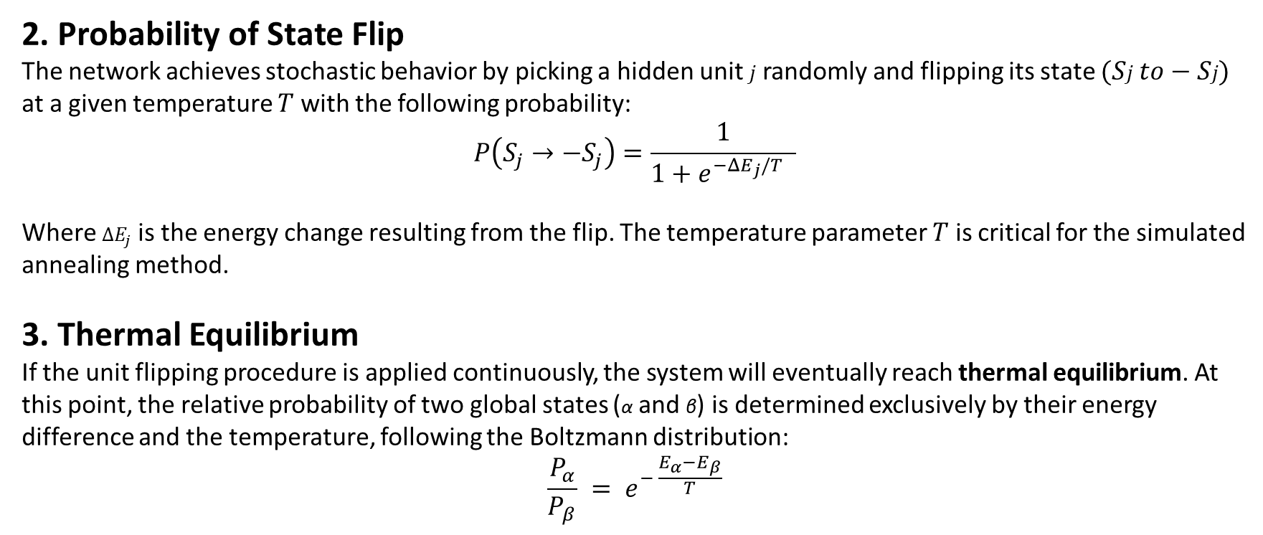
Boltzmann Machine : Mathematical Foundation
2. Probability of State Flip
The network achieves stochastic behavior by picking a hidden unit $j$randomly and flipping its state $(Sj​ to−Sj​)$ at a given temperature $T$ with the following probability:
$$P\left(S_{j}→−S_{j}\right)=\frac{1}{1+e^{−ΔE_{j}/T} }$$
Where $ΔE_{j}$is the energy change resulting from the flip. The temperature parameter $T$ is critical for the simulated annealing method.
3. Thermal Equilibrium
If the unit flipping procedure is applied continuously, the system will eventually reach thermal equilibrium. At this point, the relative probability of two global states (α and β) is determined exclusively by their energy difference and the temperature, following the Boltzmann distribution:
$$\frac{P_{α}}{P_{β}} = e^{− \frac{E_{α}−E_{β}}{T}}$$

Slide 20
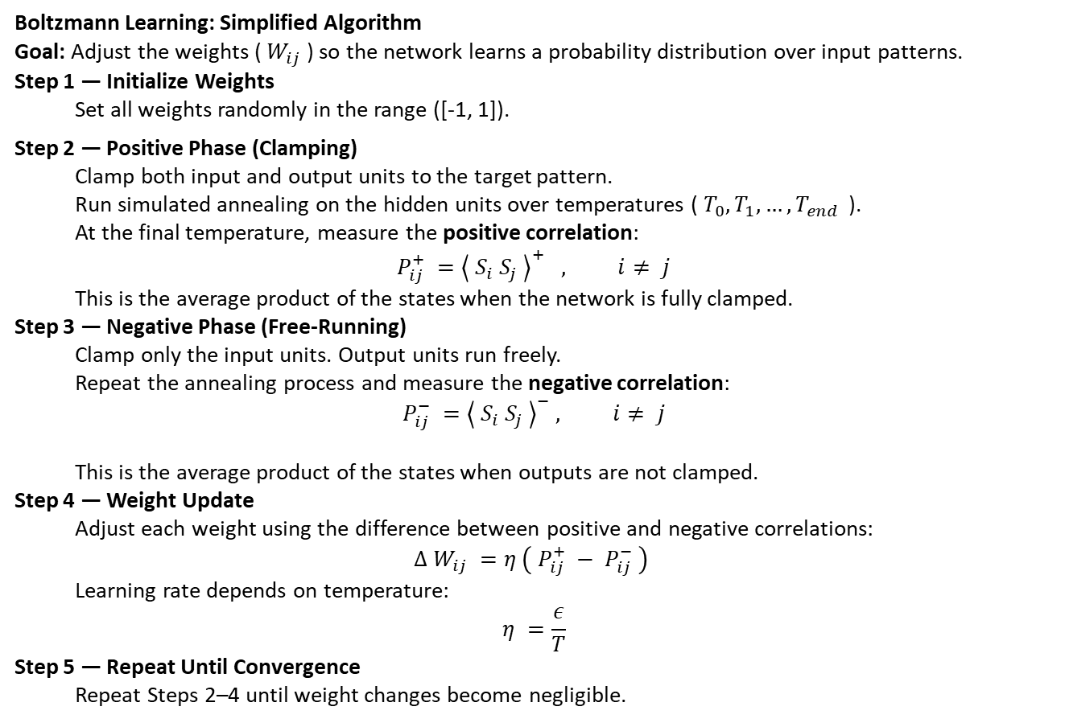
Boltzmann Machine Learning Algorithm
Boltzmann Learning: Simplified Algorithm
Goal: Adjust the weights ( $W_{ij}$) so the network learns a probability distribution over input patterns.
Step 1 — Initialize Weights
Set all weights randomly in the range ([-1, 1]).
Step 2 — Positive Phase (Clamping)
Clamp both input and output units to the target pattern.
Run simulated annealing on the hidden units over temperatures ( $T_{0}, T_{1}, …, T_{end }$ ).
At the final temperature, measure the positive correlation:
$$P_{ij}^{+} ={\left\langle S_{i} S_{j} \right\rangle }^{+} , i≠ j$$
This is the average product of the states when the network is fully clamped.
Step 3 — Negative Phase (Free-Running)
Clamp only the input units. Output units run freely.
Repeat the annealing process and measure the negative correlation:
$$P_{ij}^{−} ={\left\langle S_{i} S_{j} \right\rangle }^{−} , i≠ j$$
This is the average product of the states when outputs are not clamped.
Step 4 — Weight Update
Adjust each weight using the difference between positive and negative correlations:
$$Δ W_{ij} =η \left( P_{ij}^{+} − P_{ij}^{−} \right)$$
Learning rate depends on temperature:
$$η =\frac{ε}{T}$$
Step 5 — Repeat Until Convergence
Repeat Steps 2–4 until weight changes become negligible.
Notes:
The goal of Boltzmann learning is to adjust connection strengths (Wij​) such that the neural network categorizes input patterns according to the Boltzmann distribution. The training involves two main phases: Clamping and Free-Running.
The learning procedure steps are:
Step 1: Initialization Set weights to random numbers in the range [−1,1].
Step 2: Clamping Phase (Positive Phase) The network is presented with the mapping it is intended to learn by clamping both the input and output units to target patterns. For each pattern, simulated annealing is performed on the hidden units at a sequence of temperatures (T0​,T1​,…,Tend​). At the final temperature, statistics are collected to estimate the positive correlations (Pji+​):
Pji+​=⟨Sj​Si​⟩+,j=i(12)
This correlation represents the average product of the states of units i and j when the visible units are clamped to the training patterns.
Step 3: Free-Running Phase (Negative Phase) The calculations performed in Step 2 are repeated, but this time only the input units are clamped (the output units are allowed to operate freely). At the final temperature, the negative correlations (Pji−​) are estimated:
Pji−​=⟨Sj​Si​⟩−,j=i(13)
This correlation represents the average product of the states of units i and j when the output units are allowed to run freely (unclamped).
Step 4: Updating of Weights The synaptic weights are updated using the learning rule, which calculates the difference between the positive and negative correlations:
ΔWji​=η(Pji+​−Pji−​)(14)
Where η is a learning rate parameter, which depends on the temperature T (η=ϵ/T).
Step 5: Iterate until Convergence Steps 2 through 4 are iterated until the learning procedure converges and no further changes take place in the synaptic weights (Wji​)

Slide 21
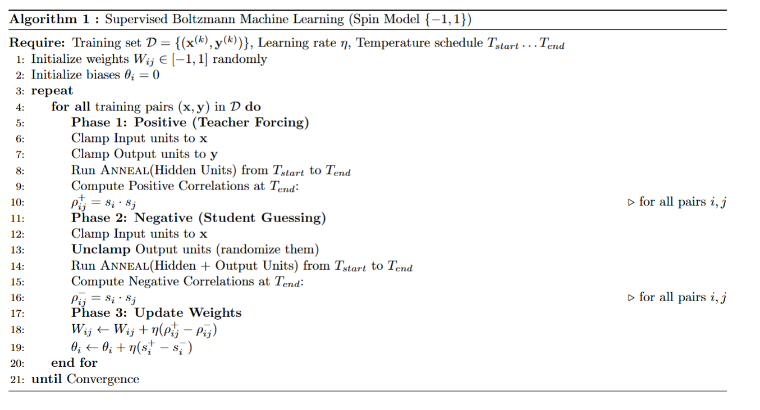
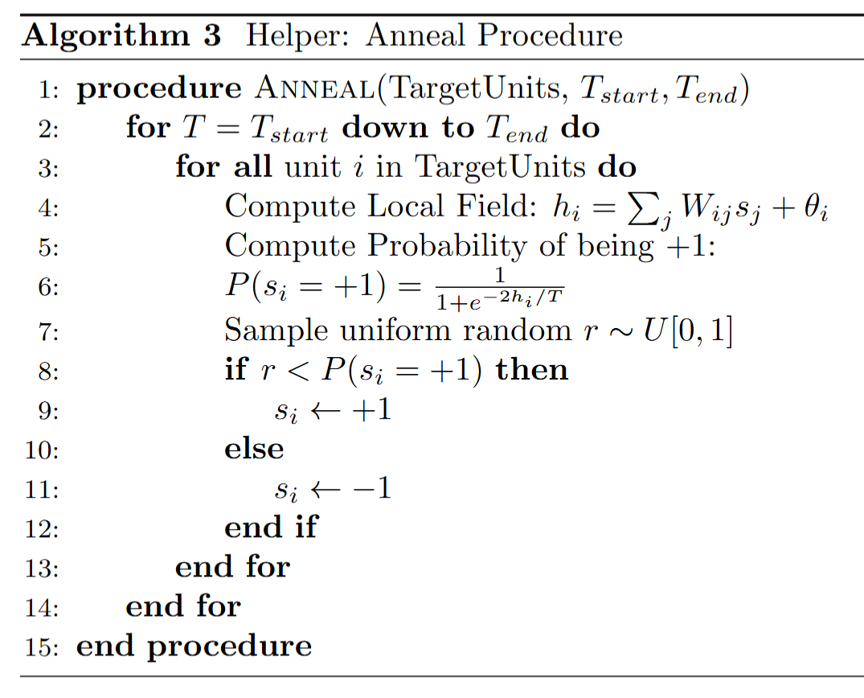
Boltzmann Machine Learning Algorithm
1. Supervised Learning (Conditional)
Use case: Classification or Regression (Input -> Output).
Phases:
Positive: Clamp Input AND Output.
Negative: Clamp Input, let Output run free.

Slide 22
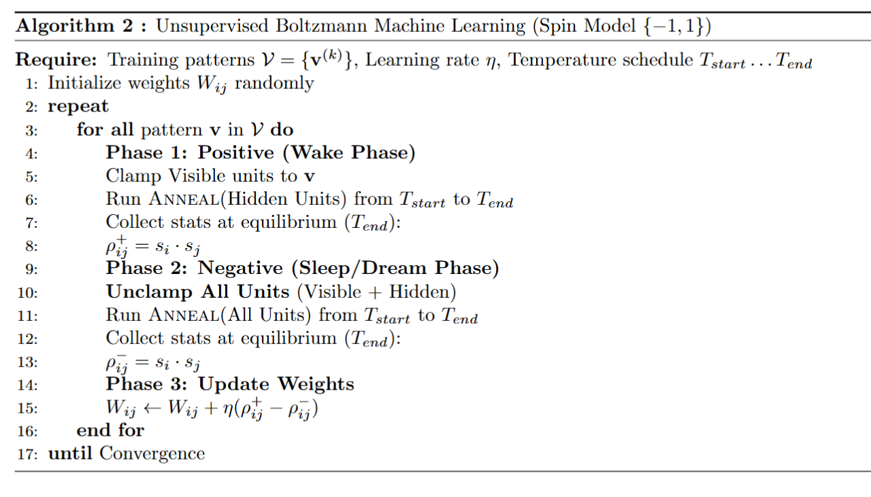
Boltzmann Machine Learning Algorithm
2. Unsupervised Learning (Generative)
Use case: Pattern Completion, Noise Reduction, Feature Learning.
Phases:
Positive: Clamp Visible Units (Input).
Negative: Unclamp Everything (Dream).
Notes:
Connection to Biology: Since your project is about biological inspiration, Scenario B (Input = Output) is actually more biologically accurate for local brain regions. A region of the brain (like the visual cortex) receives input, processes it, and represents the "cleaned up" understanding of that input on the same neurons.

Slide 23
Main Differences from the Hopfield Network
Feature | Boltzmann Machine (BM) | Hopfield Network (HN)
Units/Architecture | Can have hidden units (visible and hidden layers). | Cannot have hidden units.
Unit Type | Uses stochastic binary units that make biased random decisions. | Uses binary threshold units (deterministic).
Network Classification | A stochastic network. | A deterministic recurrent neural network.
Search/Dynamics | Uses stochastic updates (like simulated annealing) to avoid local minima. | Uses deterministic updates based on binary threshold rule, causing it to settle only to the nearest local minimum.
Applications/ Learning | Can be configured for supervised learning problems and is important for learning latent variables. | Typically used for pattern completion tasks (autoassociators) under unsupervised learning.
Training Phases | Involves a Clamping Phase and a Free-Running Phase. | Involves Phase Storage and Phase Retrieval.

Slide 24
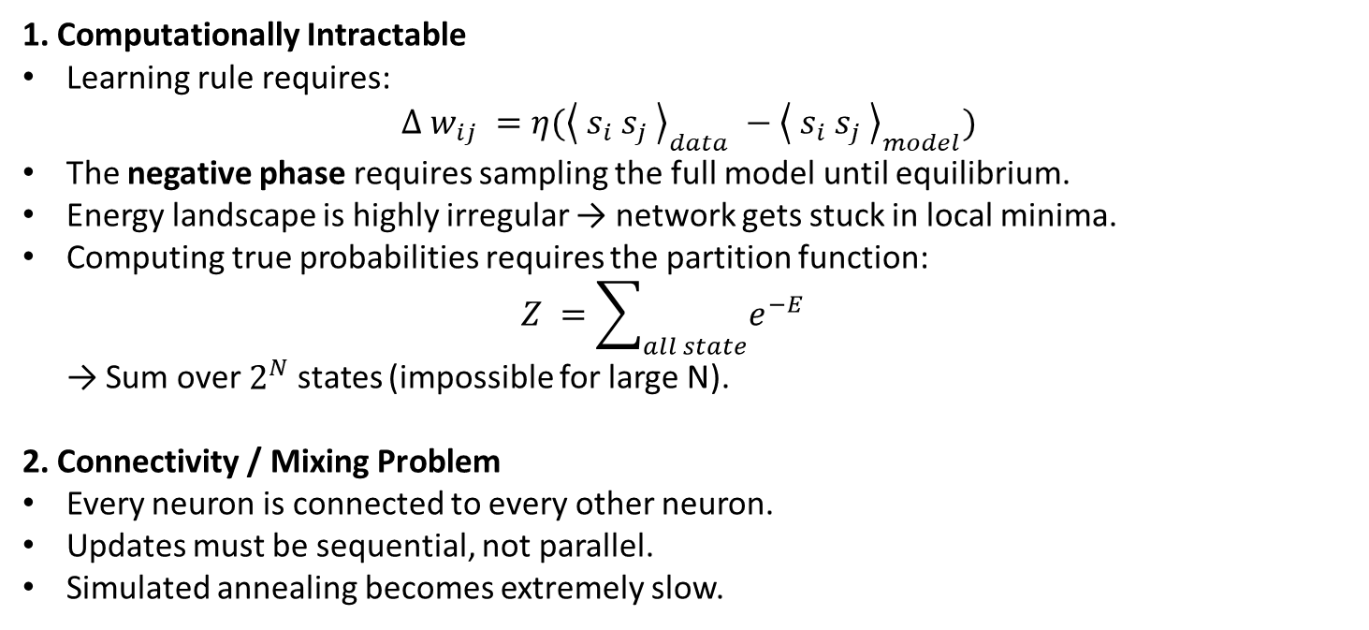
Limitations of the Fully Connected
Boltzmann Machine
1. Computationally Intractable
Learning rule requires: $Δ w_{ij} =η({\left\langle s_{i} s_{j} \right\rangle }_{data} −{\left\langle s_{i} s_{j} \right\rangle }_{model})$
The negative phase requires sampling the full model until equilibrium.
Energy landscape is highly irregular → network gets stuck in local minima.
Computing true probabilities requires the partition function: $Z =\sum_{all state}{e^{−E}}$ → Sum over$2^{N}$states (impossible for large N).
2. Connectivity / Mixing Problem
Every neuron is connected to every other neuron.
Updates must be sequential, not parallel.
Simulated annealing becomes extremely slow.

Slide 25
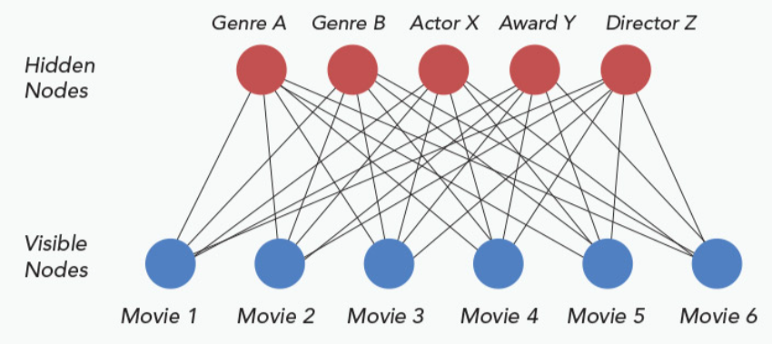
The Breakthrough:
Restricted Boltzmann Machine (RBM)
Key Structural Change:
No connections within the same layer.
Only Visible ↔ Hidden connections (bipartite graph).
Why this solves the problem:
Conditional independence: Hidden units are independent given the Visible units.
Parallel updates: Entire Hidden layer can be updated at once.
Contrastive Divergence (CD-k): Only 1–k sampling steps needed (often CD-1). → Training becomes thousands of times faster.

Slide 26
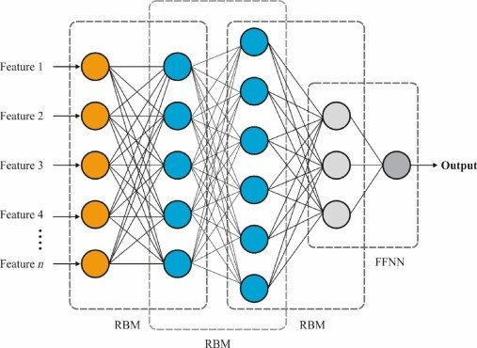
Next Step: Deep Belief Networks (DBN)
Why not stop at an RBM?
RBM is shallow → learns simple features only.
DBN idea:
Train stacked RBMs greedily, layer by layer.
Each RBM learns features for the next one.
Forms a hierarchy: pixels → edges → shapes → objects.
Impact:
First effective “deep” training method (2006).
Foundation of modern deep learning.

Slide 27
Liquid and Spiking

Slide 28
Spiking neural netwok

Slide 29
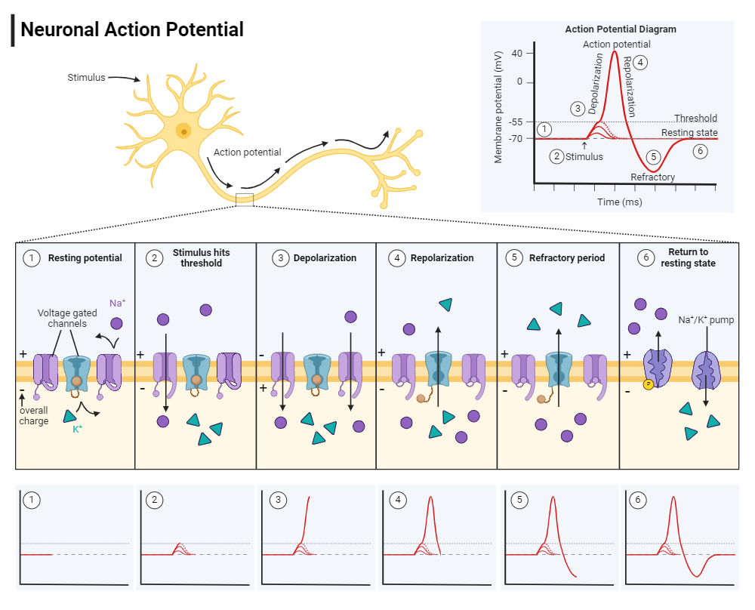
The Biological Inspiration:
The "Action Potential"
In the human brain, a neuron is like a battery that is constantly being charged and drained. It doesn't output a continuous value (like 0.8). It is binary in time: it is either silent, or it "spikes."
The Biological Cycle:
Resting State: When nothing is happening, the neuron sits at a negative voltage (approx -70mV). It is polarized.
Integration (Summation): Inputs from other neurons (via dendrites) let positive ions flow in. The voltage rises slowly.
Threshold: If the voltage hits a specific limit (approx -55mV), a gate snaps open.
Action Potential (The Spike): Positive ions rush in massively. The voltage shoots up to +40mV instantly. This is the "1" or the "Signal."
Refractory Period: The neuron effectively "crashes." It pumps ions back out, dropping below the resting state. It cannot fire again during this short recovery time.

Slide 30
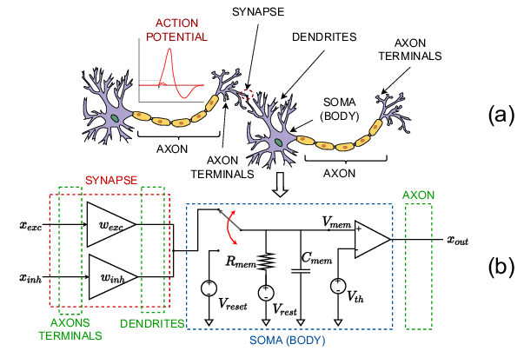
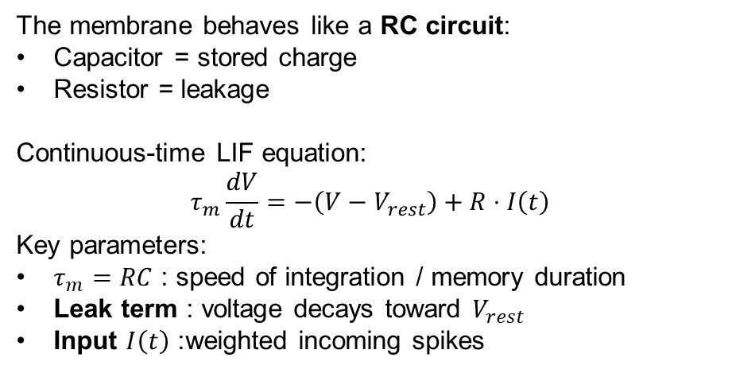
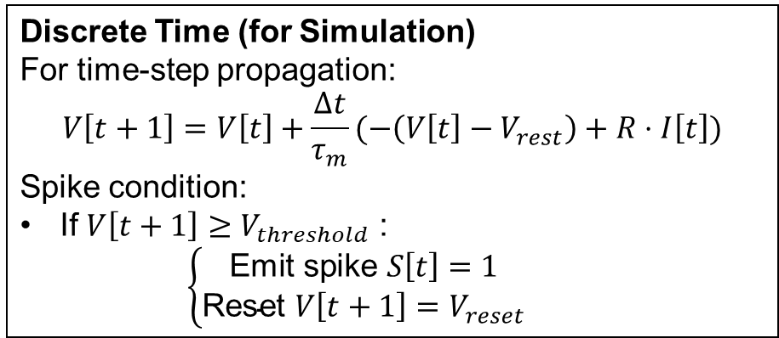
The Mathematical Model:
Leaky Integrate-and-Fire (LIF)
The membrane behaves like a RC circuit:
Capacitor = stored charge
Resistor = leakage
Continuous-time LIF equation:
$$τ_{m}\frac{dV}{dt}=−\left(V−V_{rest}\right)+R⋅I\left(t\right)$$
Key parameters:
$τ_{m}=RC$: speed of integration / memory duration
Leak term : voltage decays toward $V_{rest}$
Input $I\left(t\right)$: weighted incoming spikes
Discrete Time (for Simulation)
For time-step propagation:
$$V\left[t+1\right]=V\left[t\right]+\frac{Δt}{τ_{m}}(−\left(V\left[t\right]−V_{rest}\right)+R⋅I\left[t\right])$$
Spike condition:
If $V\left[t+1\right]≥V_{threshold}$ :
$$\left\{\begin{aligned}\text{Emit} \text{spike} S\left[t\right]=1 \\ \text{Reset} V\left[t+1\right]=V_{reset} \end{aligned}\right.$$

Slide 31
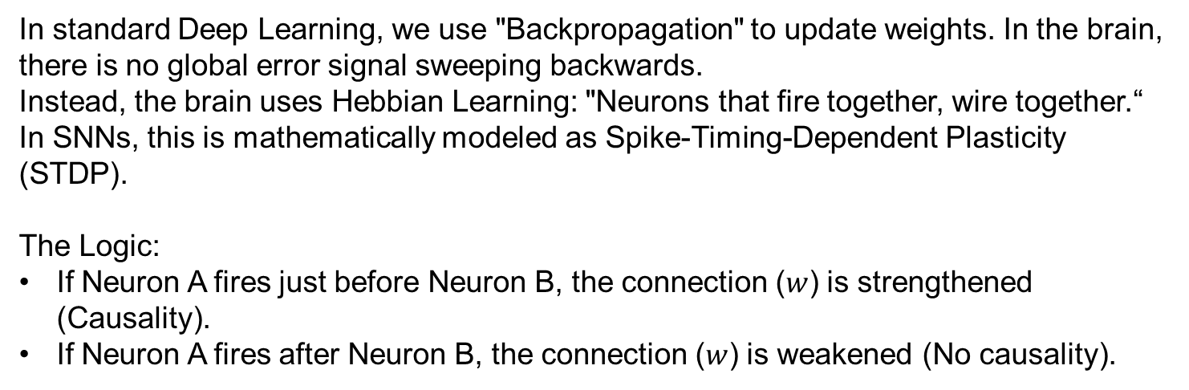
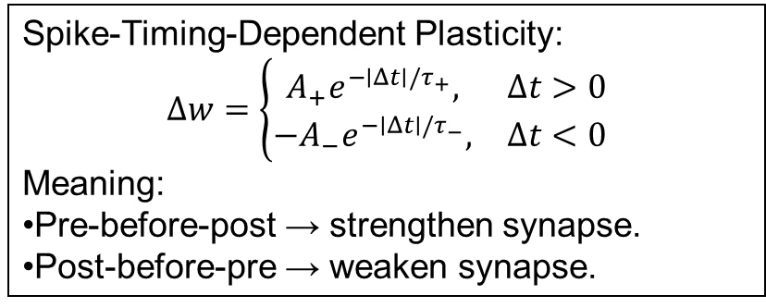
The Learning Rule: STDP
(Biological Backpropagation)
In standard Deep Learning, we use "Backpropagation" to update weights. In the brain, there is no global error signal sweeping backwards.
Instead, the brain uses Hebbian Learning: "Neurons that fire together, wire together.“
In SNNs, this is mathematically modeled as Spike-Timing-Dependent Plasticity (STDP).
The Logic:
If Neuron A fires just before Neuron B, the connection ($w$) is strengthened (Causality).
If Neuron A fires after Neuron B, the connection ($w$) is weakened (No causality).
Spike-Timing-Dependent Plasticity:
$$Δw=\left\{\begin{matrix}A_{+}e^{−∣Δt∣/τ_{+}}, & Δt>0 \\ −A_{−}e^{−∣Δt∣/τ_{−}}, & Δt<0\end{matrix}\right.$$
Meaning:
Pre-before-post → strengthen synapse.
Post-before-pre → weaken synapse.
Notes:
The Math Formula:
The change in weight ($\Delta w$) depends on the time difference $\Delta t = t_{post} - t_{pre}$:
$$\Delta w = \begin{cases} A_+ \cdot e^{-\frac{|\Delta t|}{\tau_+}} & \text{if } \Delta t > 0 \quad (\text{Potentiation}) \\ -A_- \cdot e^{-\frac{|\Delta t|}{\tau_-}} & \text{if } \Delta t < 0 \quad (\text{Depression}) \end{cases}$$
$A_+$ and $A_-$ determine the maximum amount of learning.
$\tau$ determines the time window (how close the spikes must be to matter).

Slide 32
How an SNN Processes Information
Flow of computation:
Input encoding: Convert data into spike trains (rate coding, temporal coding, or population coding).
Membrane integration: Each neuron accumulates weighted incoming spikes.
Leak: Voltage decays over time if no new spikes arrive.
Threshold crossing: When voltage reaches threshold → neuron fires.
Reset + refractory: Neuron is temporarily silent.
Spike propagation: Output spikes trigger downstream neurons.
Core principle: Computation is driven by event timing, not continuous activations.

Slide 33
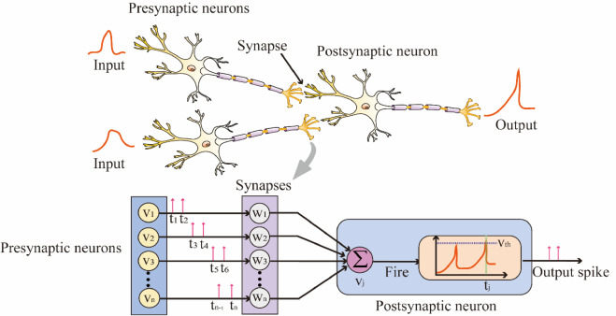
SNN Architecture Overview
Typical layered architecture:
Input Layer: Encodes sensory or numerical data into spikes.
Hidden Spiking Layers:
LIF or Izhikevich neurons
Synaptic weights
Temporal dynamics
Output Layer:
Can be spike-count based
Time-to-first-spike
Population decoding
Architectural features:
Time-dependent processing
Sparse activation (only spiking provides activity)
Energy-efficient computation

Slide 34
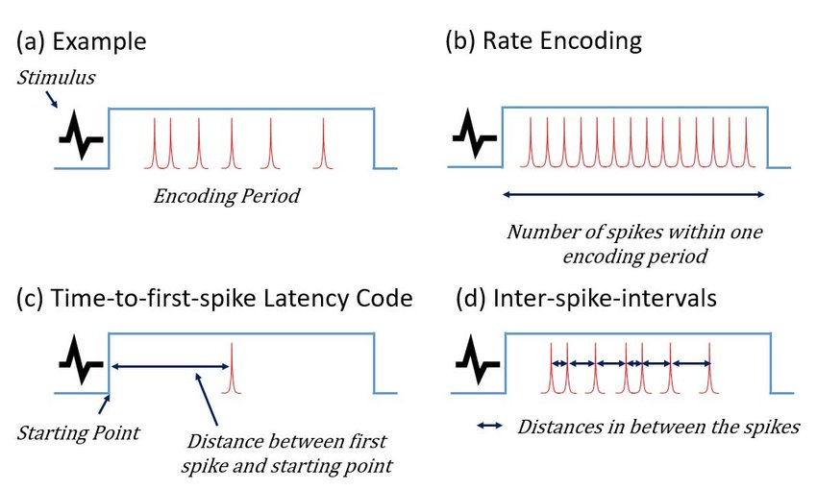
Encodings: How Raw Data Becomes Spikes
Common spike encoding methods:
Rate Coding: Higher input value → higher firing rate.
Temporal Coding: Information encoded in precise spike timing.
Latency Coding: Larger values → earlier spikes.
Population Coding: Groups of neurons encode the same stimulus.
These encodings allow SNNs to process images, sound, sensors, or numerical data.

Slide 35
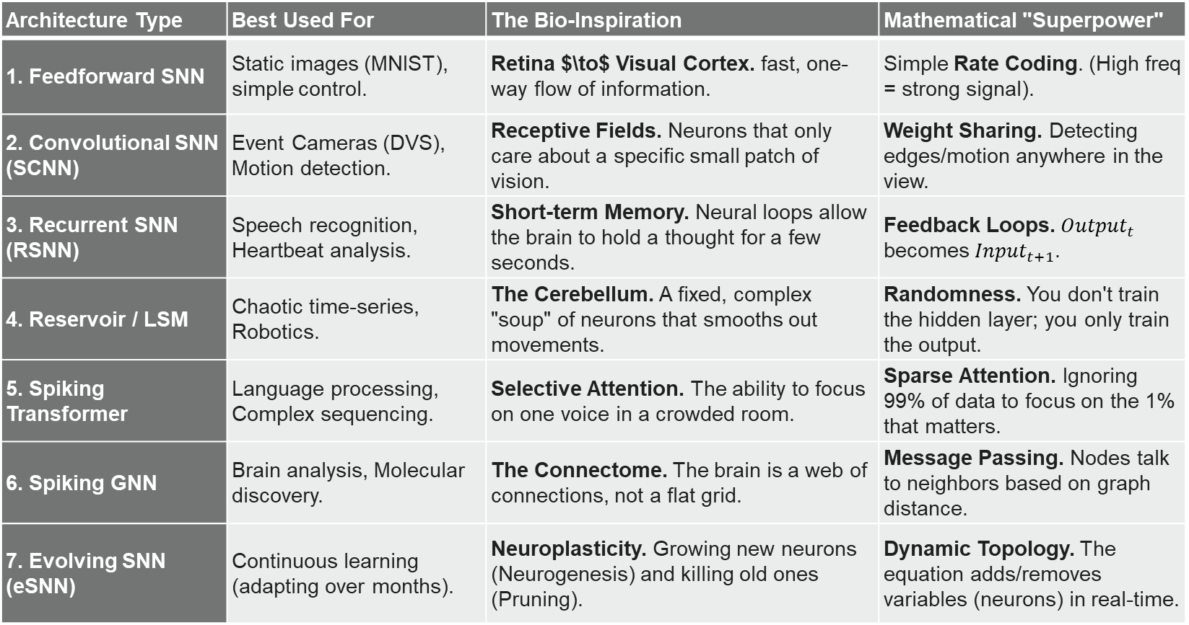
Type of SNN architecture
Architecture Type | Best Used For | The Bio-Inspiration | Mathematical "Superpower"
1. Feedforward SNN | Static images (MNIST), simple control. | Retina $\to$ Visual Cortex. fast, one-way flow of information. | Simple Rate Coding. (High freq = strong signal).
2. Convolutional SNN (SCNN) | Event Cameras (DVS), Motion detection. | Receptive Fields. Neurons that only care about a specific small patch of vision. | Weight Sharing. Detecting edges/motion anywhere in the view.
3. Recurrent SNN (RSNN) | Speech recognition, Heartbeat analysis. | Short-term Memory. Neural loops allow the brain to hold a thought for a few seconds. | Feedback Loops. ${Output}_{t}$ becomes $Input_{t+1}$.
4. Reservoir / LSM | Chaotic time-series, Robotics. | The Cerebellum. A fixed, complex "soup" of neurons that smooths out movements. | Randomness. You don't train the hidden layer; you only train the output.
5. Spiking Transformer | Language processing, Complex sequencing. | Selective Attention. The ability to focus on one voice in a crowded room. | Sparse Attention. Ignoring 99% of data to focus on the 1% that matters.
6. Spiking GNN | Brain analysis, Molecular discovery. | The Connectome. The brain is a web of connections, not a flat grid. | Message Passing. Nodes talk to neighbors based on graph distance.
7. Evolving SNN (eSNN) | Continuous learning (adapting over months). | Neuroplasticity. Growing new neurons (Neurogenesis) and killing old ones (Pruning). | Dynamic Topology. The equation adds/removes variables (neurons) in real-time.

Slide 36
Comparison: ANN vs SNN Processing
Feature | ANN | SNN
Signal | Continuous values | Binary spikes
Time | Static (no intrinsic time) | Intrinsic temporal processing
Activation | Always active | Event-driven, sparse
Computation | Matrix multiplications | Spiking + integration + reset
Learning | Backprop | STDP or surrogate gradients
Efficiency | High power use | Very low power (neuromorphic hardware)

Slide 37
Biological Components Mapped to SNN Design
Brain Element | Role | SNN Equivalent
Dendrites | Receive input signals | Weighted incoming spikes
Axon | Transmits spike to next neuron | Binary event propagation
Synapse | Adjustable connection strength | Trainable weight (w)
Membrane potential | Charge state | Voltage (V)
Threshold | Spike decision | (V_{threshold})
Refractory period | Reset + rest time | Forced (V_{reset})

Slide 38
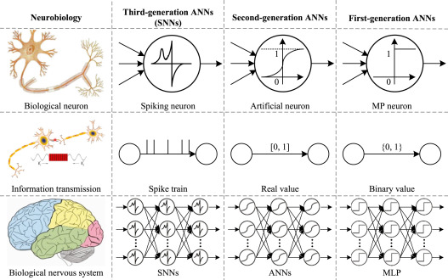
Biological Components Mapped to SNN Design

Slide 39
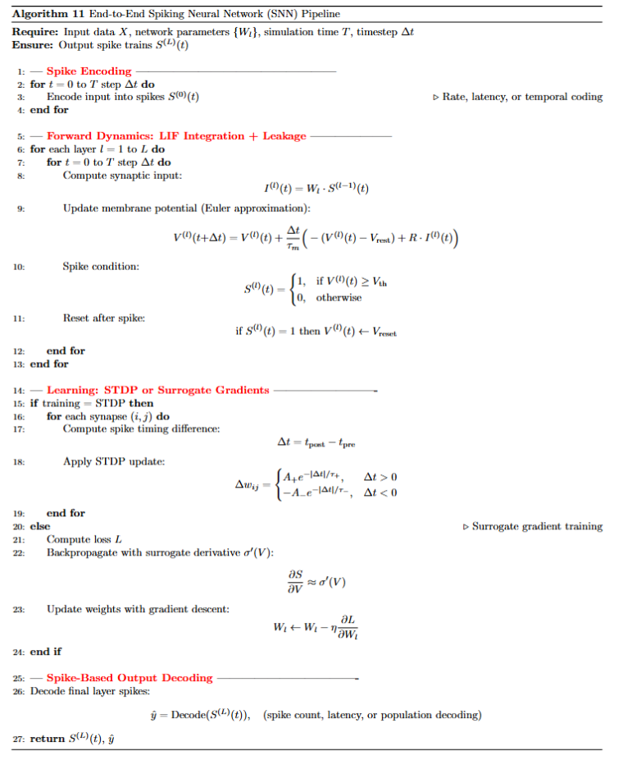
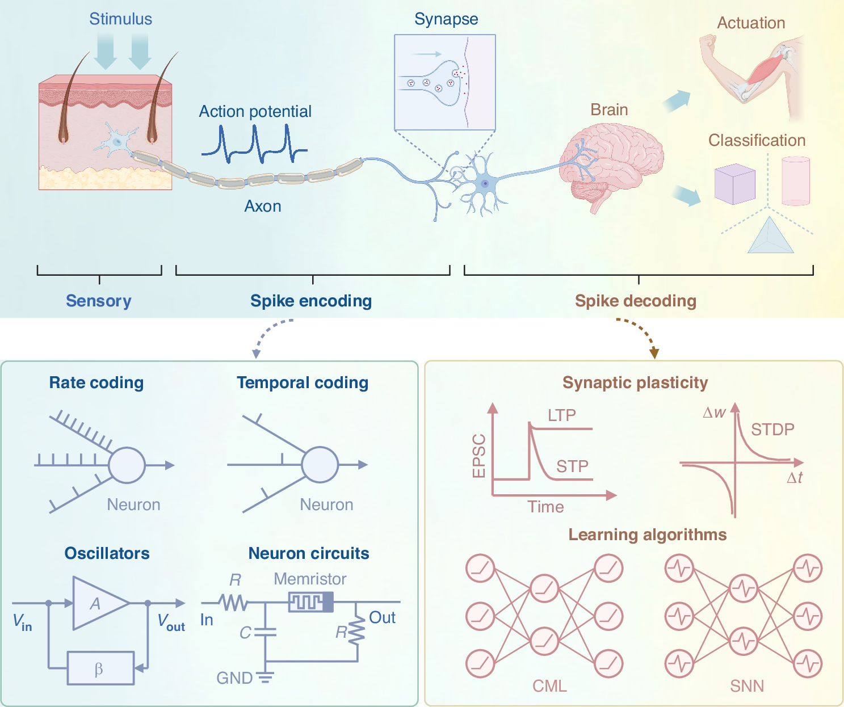
End-to-End SNN Pipeline

Slide 40
Liquid neural netwok

Slide 41
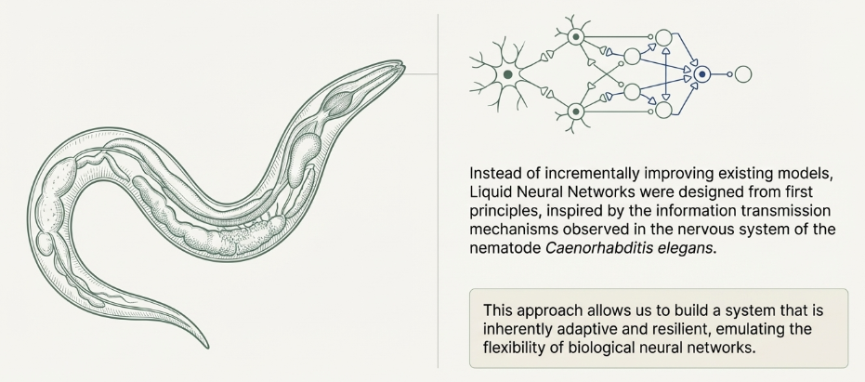
Biological Inspiration: C. elegans

Slide 42
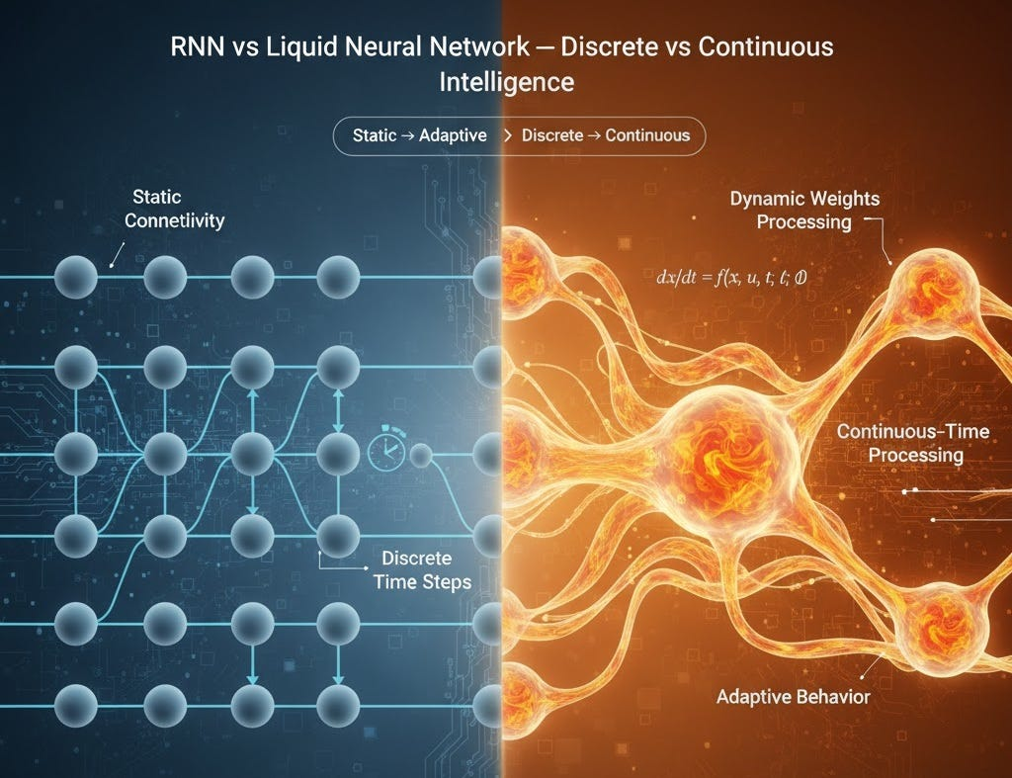
Biological Inspiration: C. elegans
While SNNs mimic the firing of a neuron (the lightning), LNNs mimic the chemistry of a neuron (the water).
LNNs are inspired by the nervous system of C. elegans (a worm with 302 neurons).
Despite its simplicity, it performs complex behavior (navigation, learning, adaptation).
Unlike human neurons, C. elegans neurons use slow chemical synapses with dynamics that change continuously.
This leads to the “Liquid” analogy:
Connections are not fixed—they change during computation.
Classical NNs = rigid pipes with fixed valves.
LNNs = flexible pipes whose shape changes as water flows.
Time constants and responses vary based on current input and current state.
Network becomes adaptive in real-time.

Slide 43
The Core Concept: Liquid Time Constants
In standard networks (and SNNs), the behavior of the neuron is fixed during the forward pass.
In LNNs, the Time Constant —which dictates how fast a neuron reacts—is not a fixed number. It is input-dependent.
Sudden Input: The time constant drops -> Neuron reacts instantly (fast reflex).
Slow Input: The time constant rises -> Neuron ignores noise and looks at the long-term trend (memory).
This allows LNNs to understand Cause and Effect better than any other network.⁹

Slide 44
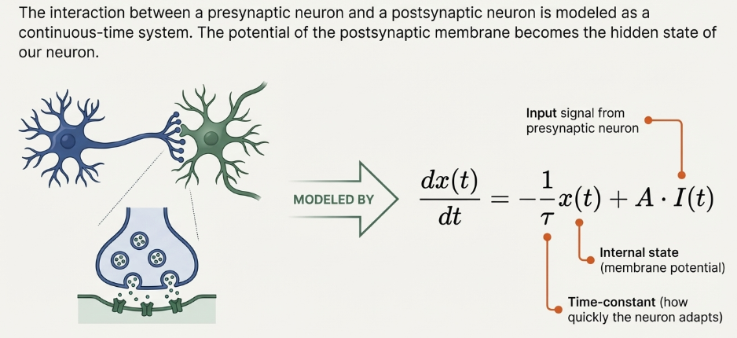
The Core Concept: Liquid Time Constants

Slide 45
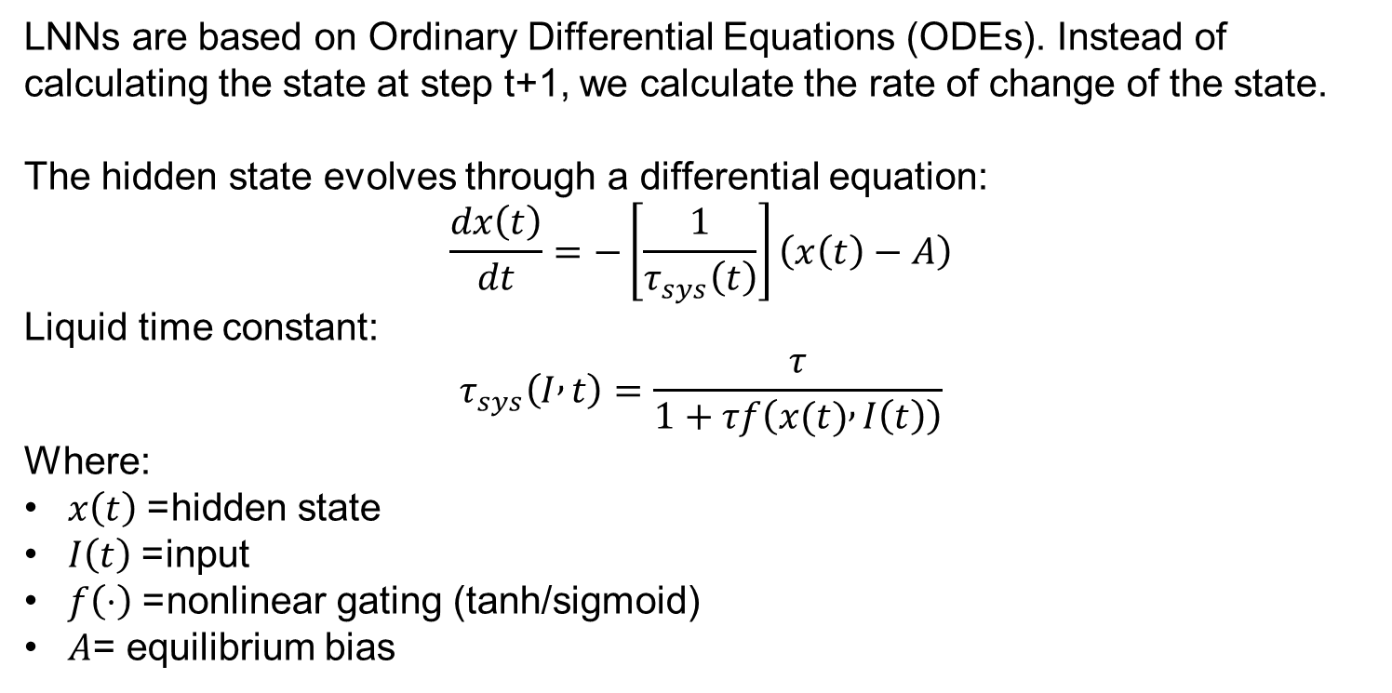
Fundamental ODE Dynamics
LNNs are based on Ordinary Differential Equations (ODEs). Instead of calculating the state at step t+1, we calculate the rate of change of the state.
The hidden state evolves through a differential equation:
$$\frac{dx\left(t\right)}{dt}=−\left[\frac{1}{τ_{sys}\left(t\right)}\right]\left(x\left(t\right)−A\right)$$
Liquid time constant:
$$τ_{sys}\left(I , t\right)=\frac{τ}{1+τf\left(x(t) , I\left(t\right)\right)}$$
Where:
$x\left(t\right)$= hidden state
$I\left(t\right)$= input
$f\left(⋅\right)$= nonlinear gating (tanh/sigmoid)
$A$= equilibrium bias

Slide 46
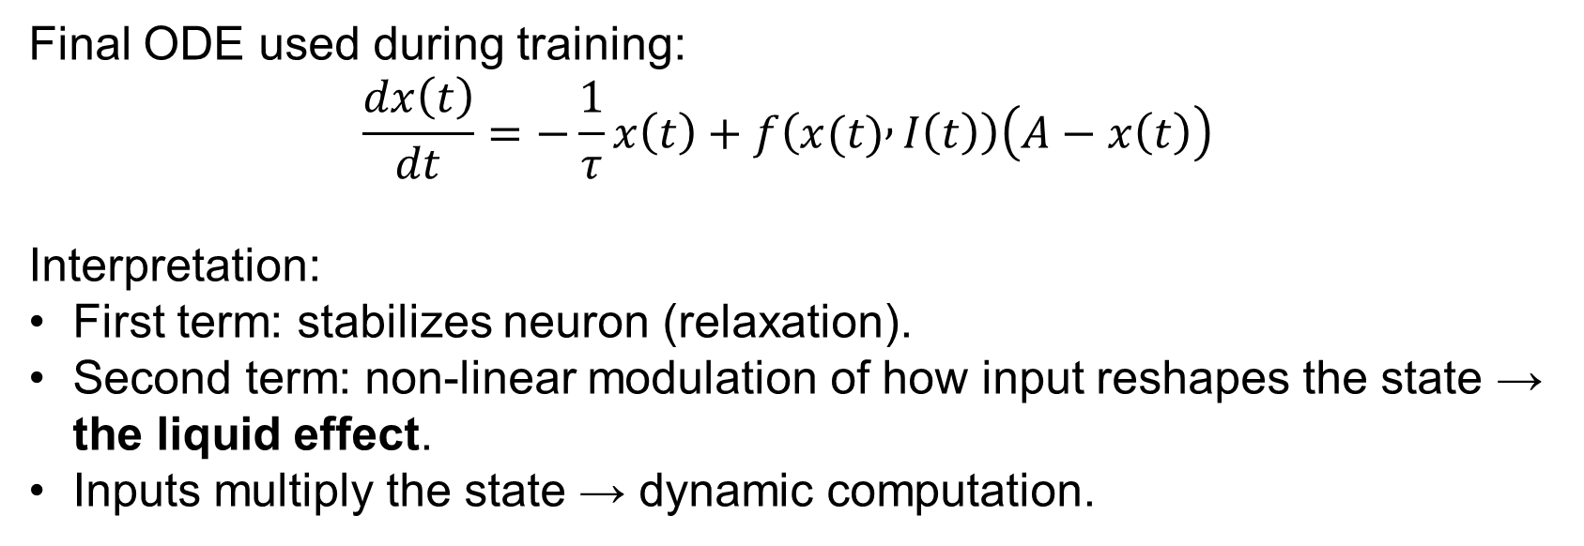
Combined Liquid Neuron Equation
Final ODE used during training:
$$\frac{dx\left(t\right)}{dt}=−\frac{1}{τ}x\left(t\right)+f\left(x(t) , I\left(t\right)\right)\left(A−x\left(t\right)\right)$$
Interpretation:
First term: stabilizes neuron (relaxation).
Second term: non-linear modulation of how input reshapes the state → the liquid effect.
Inputs multiply the state → dynamic computation.

Slide 47
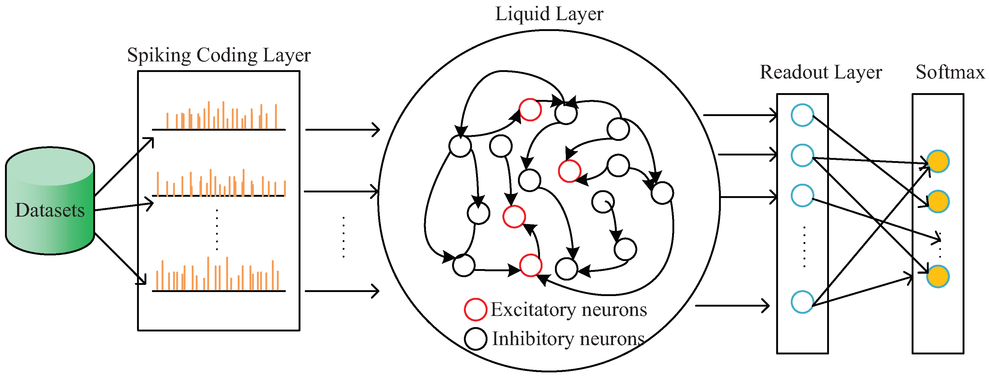
Neuronal Architecture
A. The Dynamic Core (The Liquid)
Instead of layers of static neurons, you have a "reservoir" or a "block" of ODE neurons.
Interlinking: Neurons are connected to themselves and each other laterally.
Solver: You do not just run a matrix multiplication. To get the output, the network must use an ODE Solver (like the Runge-Kutta method) to simulate the system forward in time.
B. The Architecture Stack
Input Layer: Receives time-series data (e.g., sensor data from a robot).
Liquid Layer (LTC): The ODE solver processes the inputs. It calculates the trajectory of the hidden state x(t) over continuous time.
Output Head: A standard linear layer that takes the final state x(T) and predicts the next value.

Slide 48
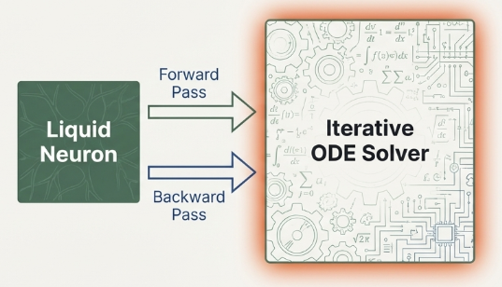
The Problem of Perfection:
Solving ODEs Is Expensive
Core Issue: Liquid Neural Networks rely on continuous-time ODEs. Solving these ODEs for every neuron at every timestep is computationally heavy.
Why it's expensive:
Requires iterative numerical solvers (Euler, RK2, RK4).
Each step requires multiple function evaluations:
RK4 → 4 evaluations per step.
Complexity increases with:
Length of time series
Number of neurons
Desired accuracy
Result: Early LNN models were too slow for large-scale or real-time ML tasks.

Slide 49
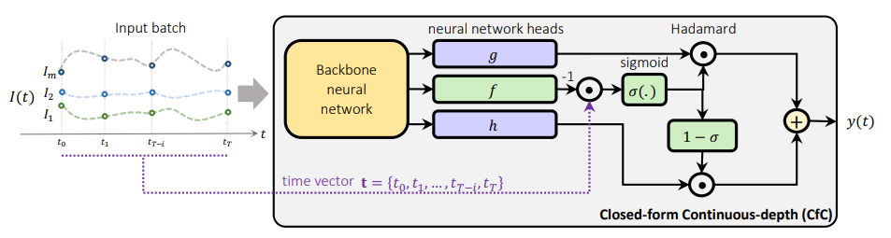
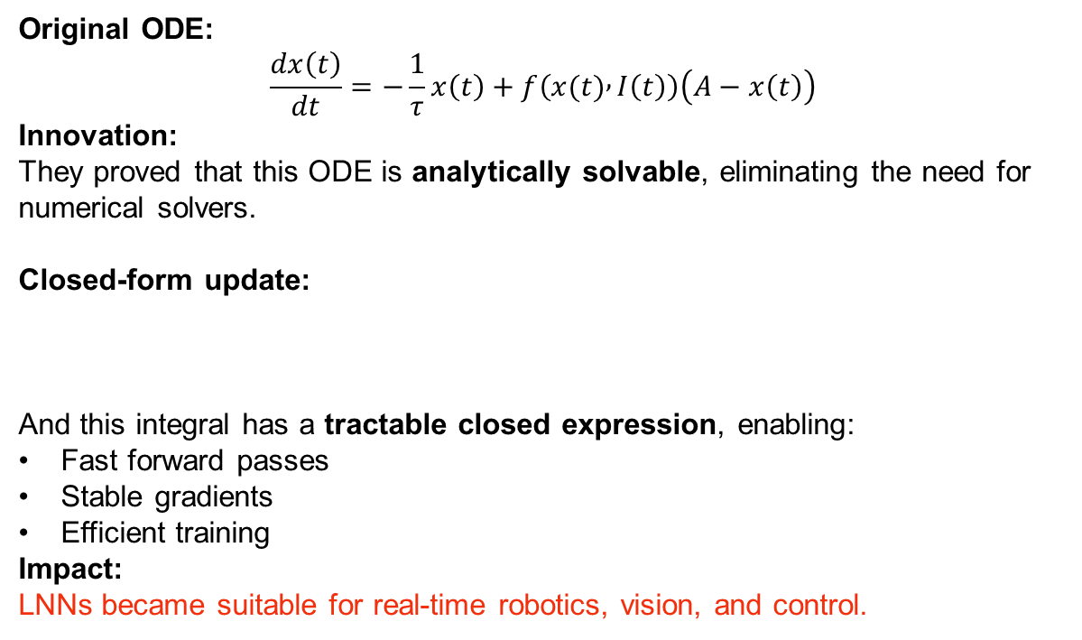
The Breakthrough:
Closed-Form Liquid Neurons
Original ODE:
$$\frac{dx\left(t\right)}{dt}=−\frac{1}{τ}x\left(t\right)+f\left(x(t) , I\left(t\right)\right)\left(A−x\left(t\right)\right)$$
Innovation: They proved that this ODE is analytically solvable, eliminating the need for numerical solvers.
Closed-form update:
And this integral has a tractable closed expression, enabling:
Fast forward passes
Stable gradients
Efficient training
Impact: LNNs became suitable for real-time robotics, vision, and control.

Slide 50
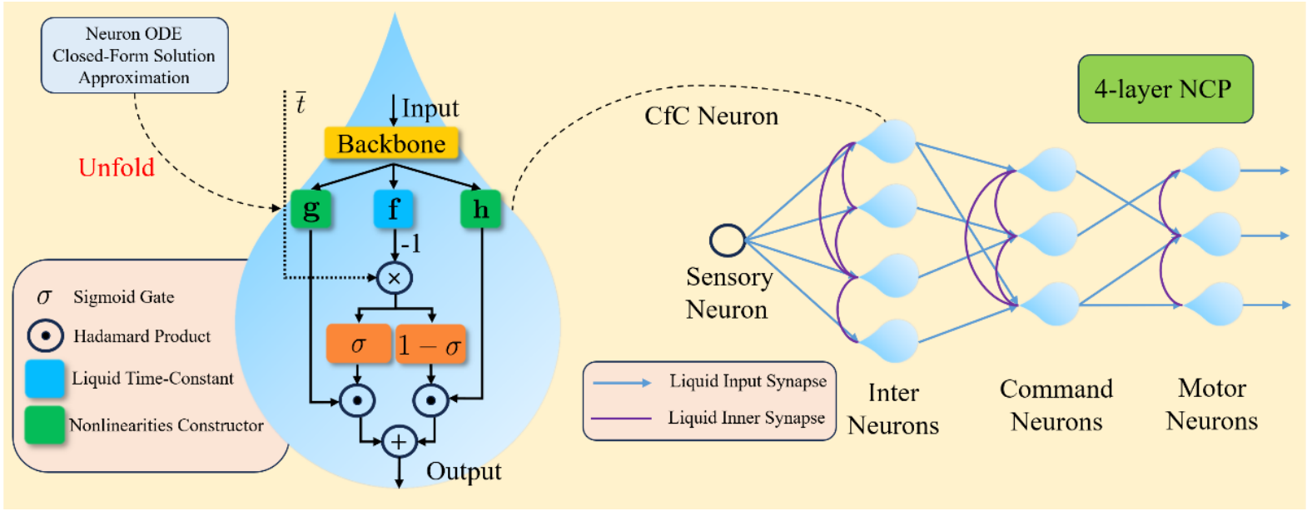
From Neurons to Circuits:
Neural Circuit Policies (NCP)
Concept: A Liquid Neural Network becomes powerful only when its neurons are organized like a biological microcircuit.
NCP = A structured liquid architecture inspired by C. elegans brain wiring.
NCPs contain four specialized neuron groups:
Input Neurons
Receive sensor or time-series signals.
Inter Neurons (Liquid Neurons)
Connected recurrently with liquid time-constant dynamics.
This forms a small liquid reservoir.
Command Neurons
Extract higher-level temporal features from inter neurons.
Act as decision-making units.
Motor Neurons (Output)
Produce final control outputs (e.g., steering, prediction, classification).
Structure resembles a biological microcircuit.

Slide 51
Why NCPs Work: Functional Connectivity
NCPs enforce structured sparsity:
Dense recurrent connectivity inside the Liquid block.
Sparse directional connections from Inter → Command → Motor.
Each connection modeled by a liquid neuron ODE.
This:
Increases interpretability
Ensures stable signal propagation
Enables causal reasoning
Allows small networks to outperform very large ones

Slide 52
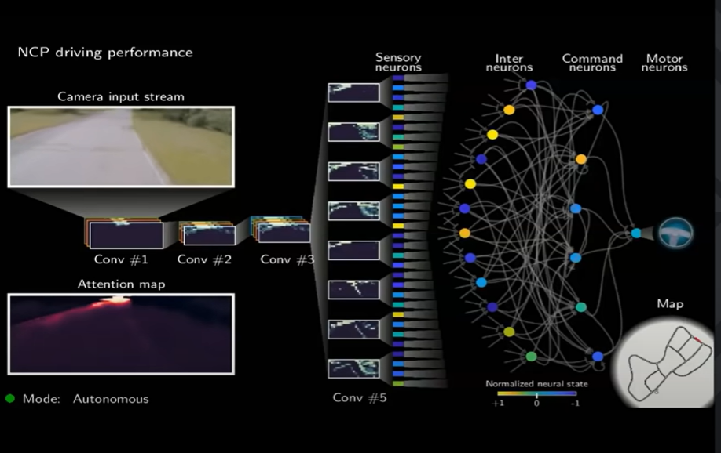
Example: 19-Neuron Liquid Circuit Driving a Car
Hasani et al. showed:
A liquid microcircuit with 19 neurons
Outperformed deep CNNs and LSTMs with thousands of parameters
In autonomous steering on real-world driving datasets
Reasons for high performance:
Adaptive temporal dynamics
Strong generalization
Continuous-time modeling of cause → effect
Built-in stability from ODE formulation
https://youtu.be/RI35E5ewBuI

Slide 53
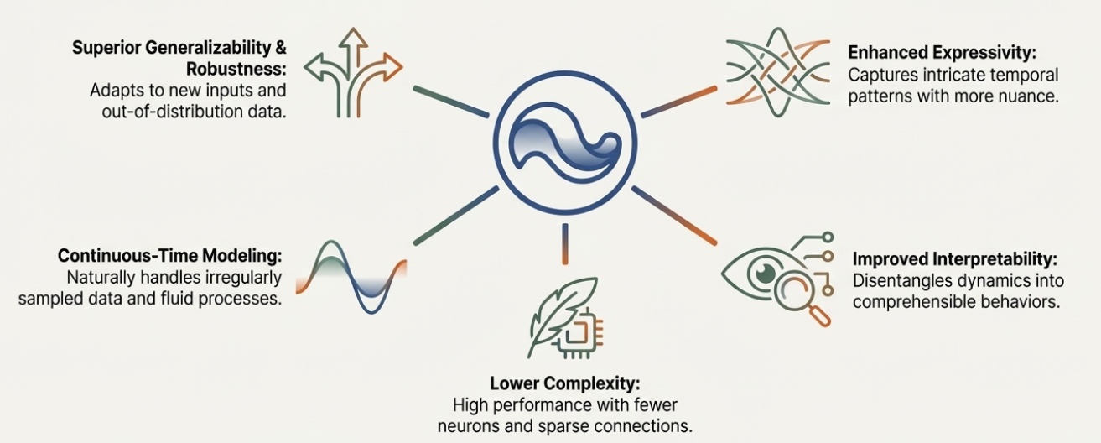
The Liquid advantages

Slide 54
References SNN
https://www.biorender.com/template/neuronal-action-potential
https://arxiv.org/pdf/1804.08150
https://neuro4ml.github.io/reading-5
https://arxiv.org/pdf/2305.08879
https://theaisummer.com/spiking-neural-networks/
https://www.mdpi.com/1424-8220/20/10/2756
https://www.sciencedirect.com/science/article/abs/pii/S0893608020300563
https://www.mdpi.com/1424-8220/20/10/2756
https://www.mdpi.com/2504-2289/7/2/110
Avancé à revoir plus tard
https://www.nature.com/articles/s41598-023-43488-x

Slide 55
References LNN
https://arxiv.org/pdf/2504.02352
https://weeklyreport.ai/briefings/liquid-neural-networks/
https://www.researchgate.net/figure/Conceptual-architecture-of-a-Liquid-Neural-Network-LNN-Input-layer-left-m-input_fig1_396372611
https://www.frontiersin.org/files/Articles/1023470/fnins-16-1023470-HTML-r1/image_m/fnins-16-1023470-g001.jpg
https://papers.nips.cc/paper_files/paper/2018/file/69386f6bb1dfed68692a24c8686939b9-Paper.pdf
https://arxiv.org/pdf/1803.08554
https://www.mdpi.com/2227-7390/10/11/1844
https://www.mdpi.com/2504-2289/7/2/110
https://www.signalpop.com/2023/08/11/closed-form-continuous-time-liquid-neural-net-models-a-programmers-perspective/
https://www.nature.com/articles/s42256-022-00556-7
https://www.linkedin.com/pulse/19-neurons-self-driving-car-neural-odes-liquid-stepan-lavrinenko-u0fwc/
Avancé a revoir plus tard
https://www.medrxiv.org/content/10.1101/2025.02.09.25321975v1.full
https://arxiv.org/html/2507.21377v1
https://arxiv.org/pdf/2405.06561
https://www.sciencedirect.com/science/article/pii/S0893608019300784

